Slide 1
The roaring 20’s: culture
Eric Aulbach and Thomas Piccione

Slide 2
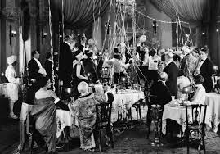
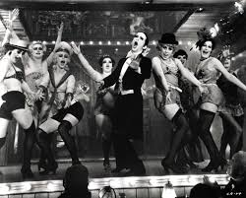
The Sexual revolution
Young men and women of the time challenged behavior set by previous generations
New behavior included throwing giant parties, drinking alcohol despite it being deemed illegal, and new types of dancing
This type of behavior is widely shown in The Great Gatsby

Slide 3
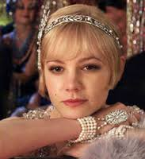
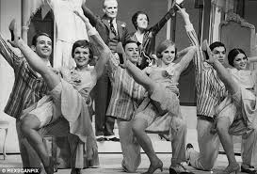
Flappers
A main icon of the Roaring 20’s was the flapper
These were young women who were part of the sexual revolution
They cut their hair short, wore knee length skirts, and long necklaces
Few women of the time fell into this category
The media used flappers as a way to express the rebellious behavior during this time
The type of clothing and hairstyle Daisy, Jordan, and other females have in the book and movie fall under this category

Slide 4
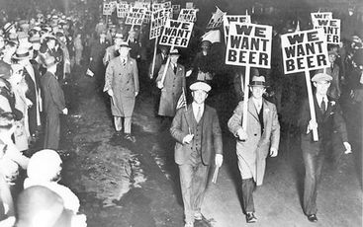
Prohibition
Alcohol was deemed illegal by the US Government in 1920
During this time period, law enforcement was corrupt, especially in big cities
This lead to bootlegging alcohol and was a factor in the rise of organized crime in the US
Gatsby himself was a bootlegger in the novel, which is how he obtained his fortune
Prohibition was treated as a joke, and was finally repealed in 1933

Slide 5
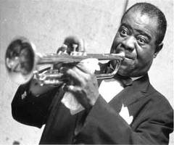
Jazz age and harlem renaissance
Jazz music and literature was produced in vast numbers, especially in African American communities, like Harlem
Jazz began gaining great popularity in the 20’s
This is the type of music that was popular during the time setting of The Great Gatsby
Famous jazz figures included Louis Armstrong and Duke Ellington
Great works of literature also sprung from black communities from writers such as Langston Hughes

Slide 6
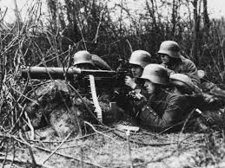
The lost generation
Americans who returned from World War I were deemed the Lost Generation
They were scarred by the images of war
This generation was also not spiritualistic, compared to previous generations
This generation was very materialistic and wealth driven, like Jay Gatsby
This generation was written about in many novels by authors such as F. Scott Fitzgerald (the author of The Great Gatsby) and Ernest Hemingway

Slide 7
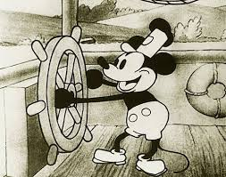
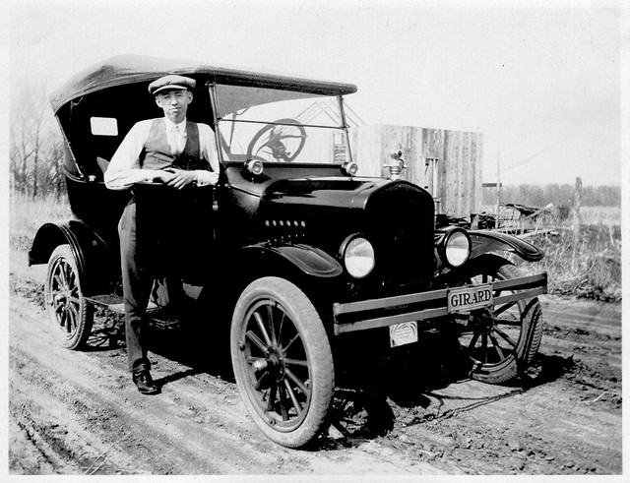
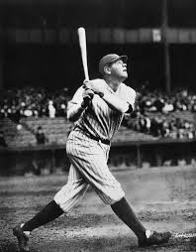
POP culture
The automobile was being mass produced by companies such as ford
Movies became a very popular topic of the time, which led to the fame of actors such as Charlie Chaplin and the first sound animated film, Steamboat Willie
Magazines gained popularity, and Time was established in 1923
Sports stars such as one of the greatest baseball players ever Babe Ruth and legendary boxer Jack Dempsey saw great popularity
College football began its rise to fame with the great success of Notre Dame
In 1927, Charles Lindbergh became the first person to fly non-stop across the Atlantic, instantly making him an American hero

